Slide 1


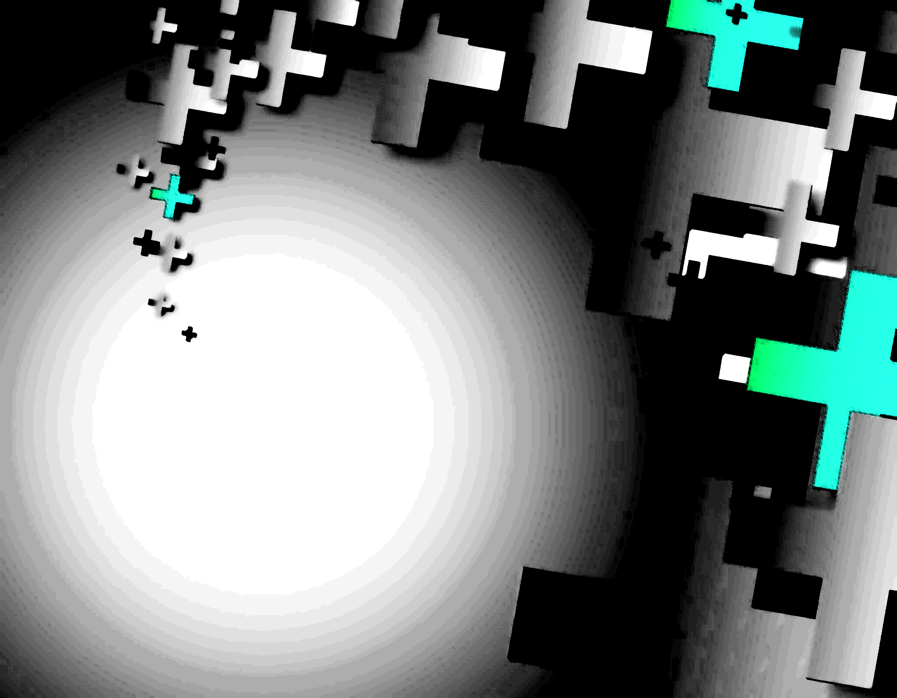
Presentation title
Reinventing Urban Futures: Regenerative Cities for a Resilient Planet
Author name
Presentation date

Slide 2
Contents
Reinventing Urban Futures: Regenerative Cities for a Resilient Planet
ISF Conference 2026: Leicester UK

Slide 3
Background
Reinventing Urban Futures: Regenerative Cities for a Resilient Planet
ISF Conference 2025: Leicester UK

Slide 4
Research questions
Reinventing Urban Futures: Regenerative Cities for a Resilient Planet
ISF Conference 2026: Leicester UK

Slide 5
Methodology
Reinventing Urban Futures: Regenerative Cities for a Resilient Planet
ISF Conference 2026: Leicester UK

Slide 6
Main findings…1
Reinventing Urban Futures: Regenerative Cities for a Resilient Planet
ISF Conference 2026: Leicester UK

Slide 7
Main findings…2
Reinventing Urban Futures: Regenerative Cities for a Resilient Planet
ISF Conference 2026: Leicester UK

Slide 8
Main findings…3
Reinventing Urban Futures: Regenerative Cities for a Resilient Planet
ISF Conference 2026: Leicester UK

Slide 9
Conclusions
Towards Resilient and Sustainable Cities and Communities
ISF Conference 2026: Leicester UK

Slide 10
Useful info
Reinventing Urban Futures: Regenerative Cities for a Resilient Planet
Contact details
ISF Conference 2026: Leicester UK

